Slide 1

NBA STATS
WEB
SCRAPER
IS392 Final Project
Completed By: Irfan Rathore, Mahmoud Alkayat, Md Rapu, Mithil Patel & Husain Attarwala

Slide 2


PROJECT OVERVIEW
Finding a common interest of basketball 🏀 within the group members, we decided to do an analysis of various statistics of some of the top basketball players in the NBA.
Using Kaggle, we found 3 main databases that would be most useful to provide data for what we needed. Using these databases, we were able to use different python libraries to derive the information we needed.

Slide 3
AGENDA
01
Databases we found
02
Libraries used to extract and clean data
03
Statistics/Clustering we broke down for players
05
Conclusion to be made based on analysis
OUR PROCESS

Slide 4
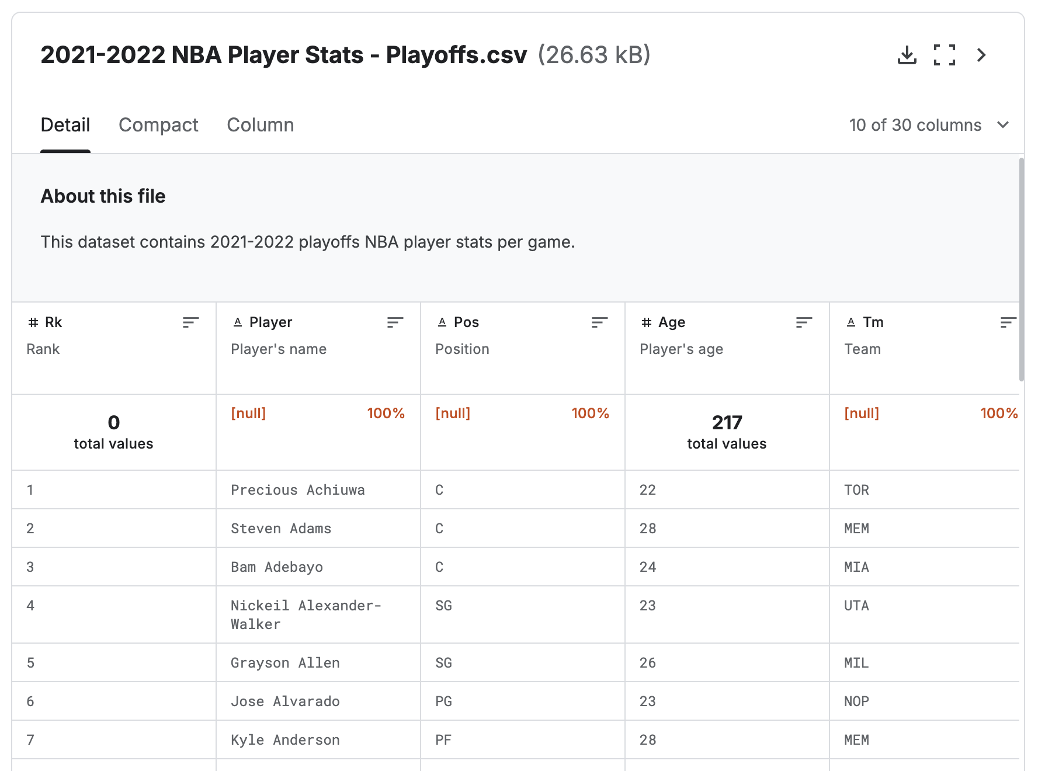
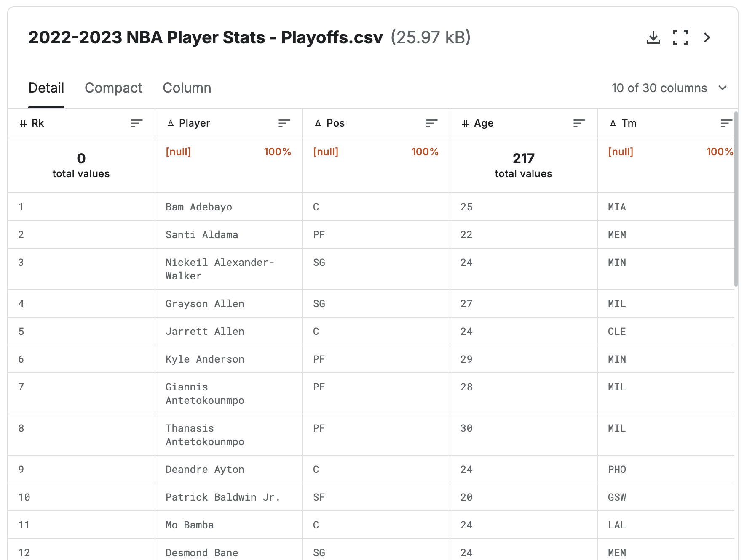
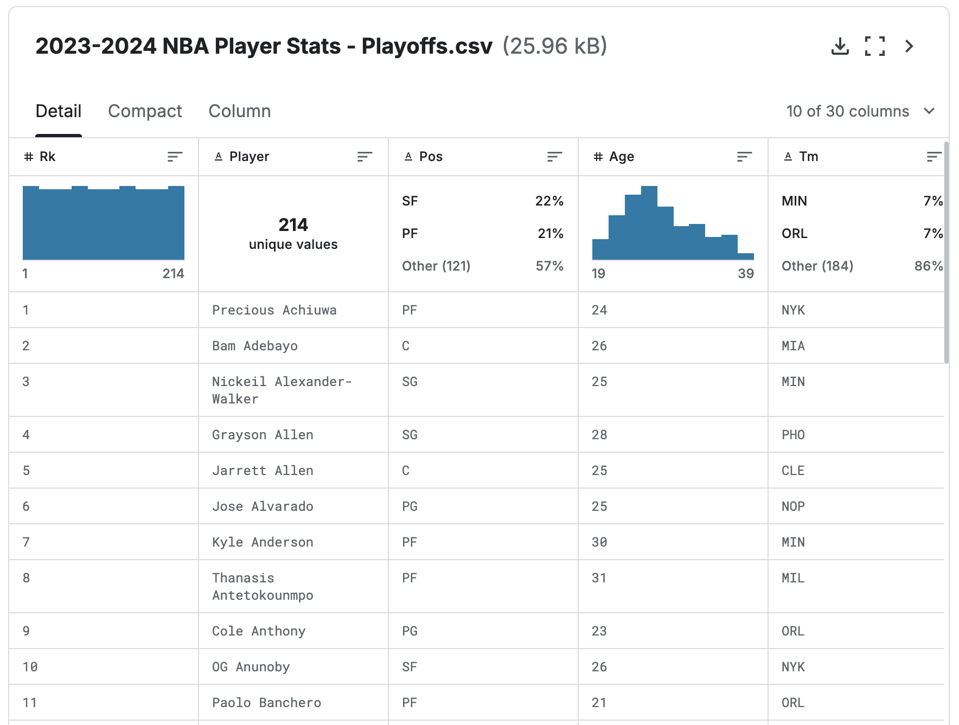
The Databases
The databases all have stats from individual players from the past three seasons. Details of the players include their name, team, age, position, games played, game started, minutes played per game, field goals per game, and attempts per game.
2021-2022 Dataset
2022-2023 Dataset
2023-2024 Dataset
Database Link
Database Link
Database Link

Slide 5
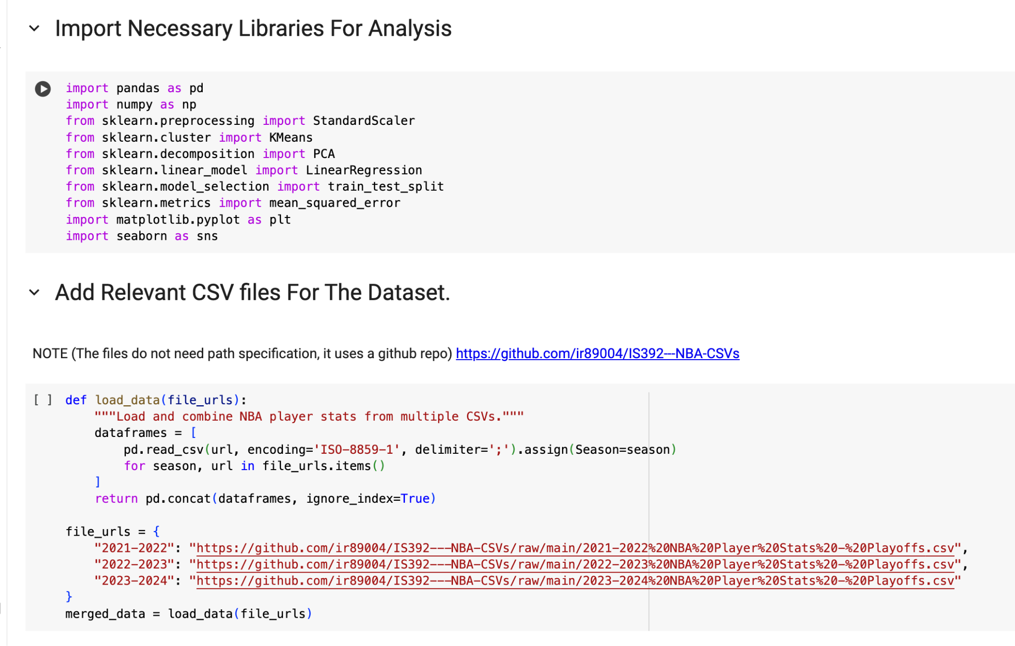
Extracting & Cleaning Data
We chose Python as our language for our analysis. First we had to load Kaggle’s databases into our software, so we read those files which were in csv and loaded them into Google CoLab. For the analysis, we used various methods from various python libraries that we imported into our code.

Slide 6
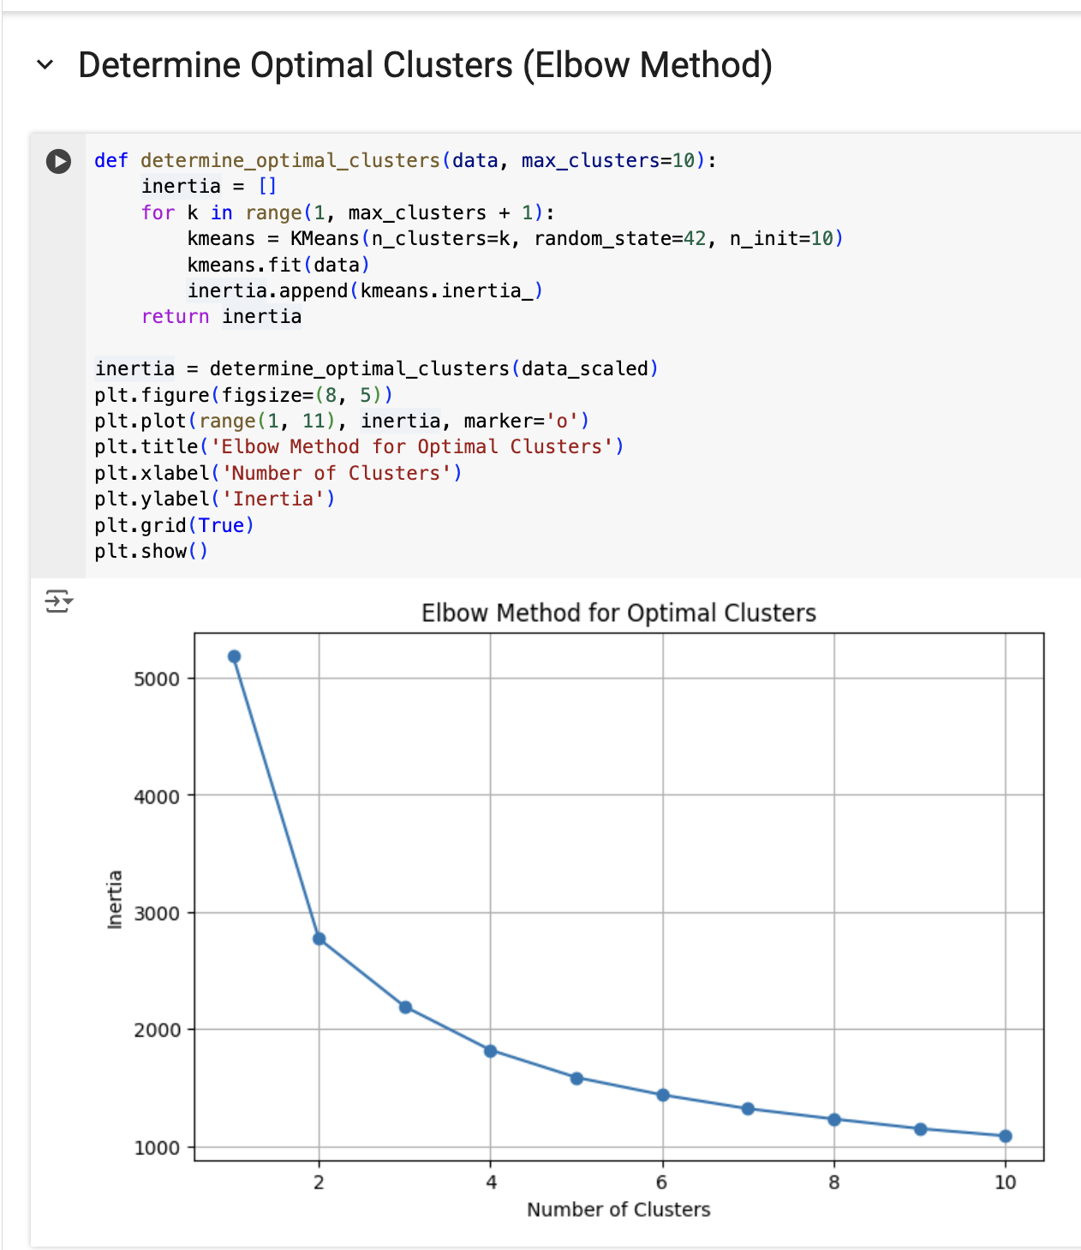
Elbow Method
The Elbow Method helps determine the optimal number of clusters for K-means clustering by calculating inertia (the sum of squared distances from points to their cluster center) for cluster counts from 1 to 10. The 'elbow' point on the graph shows where adding more clusters stops significantly improving the model. For this analysis, 3 clusters were chosen as optimal, balancing simplicity and meaningful insights. This ensures the clusters are accurate without being too general or too specific, providing clear segmentation of NBA players into offensive superstars, role players, and defensive specialists.

Slide 7
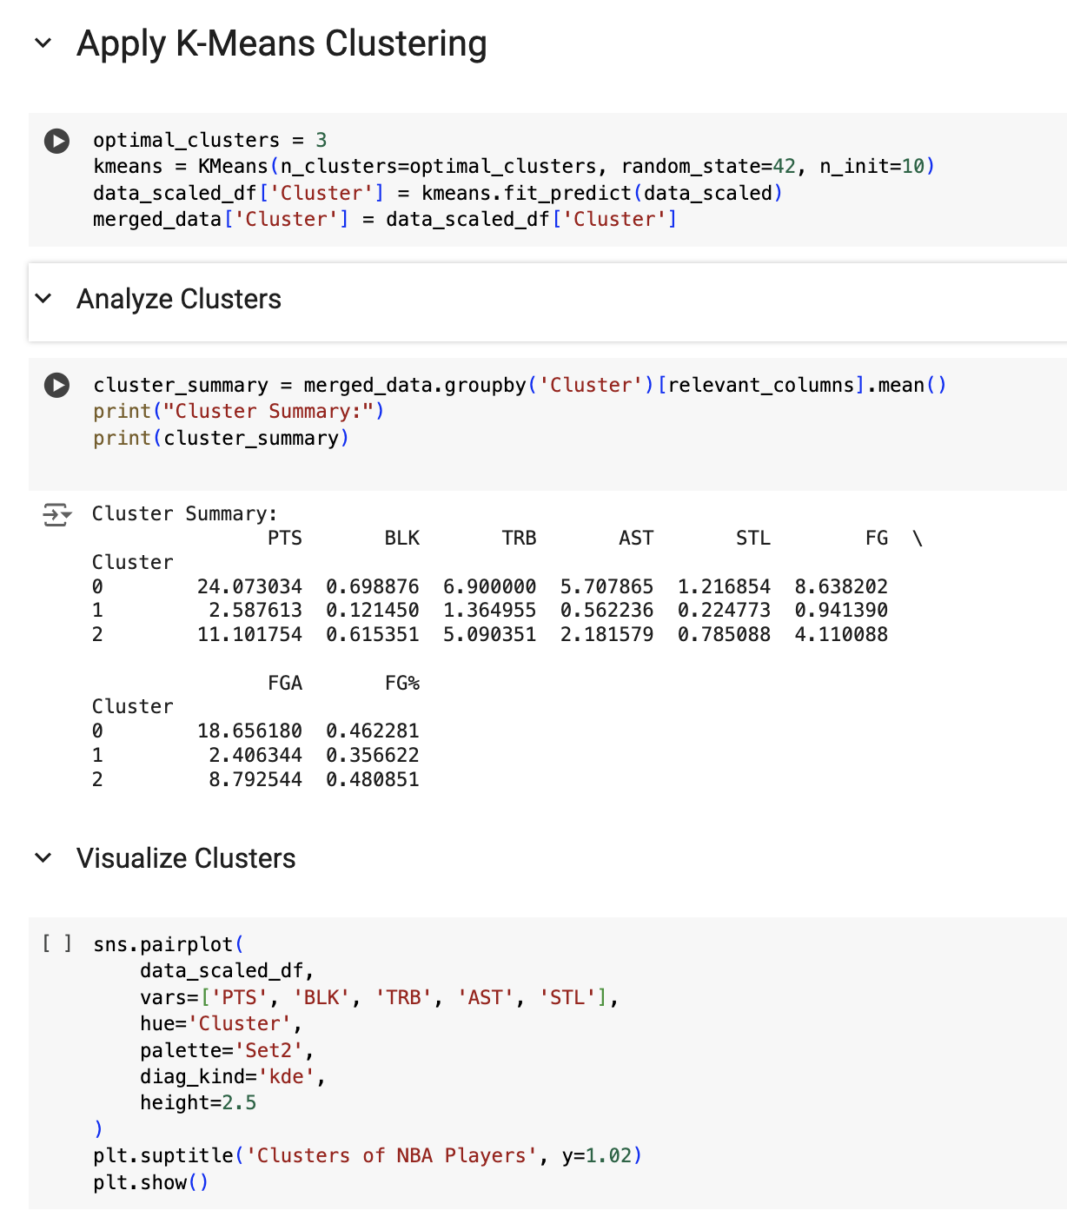
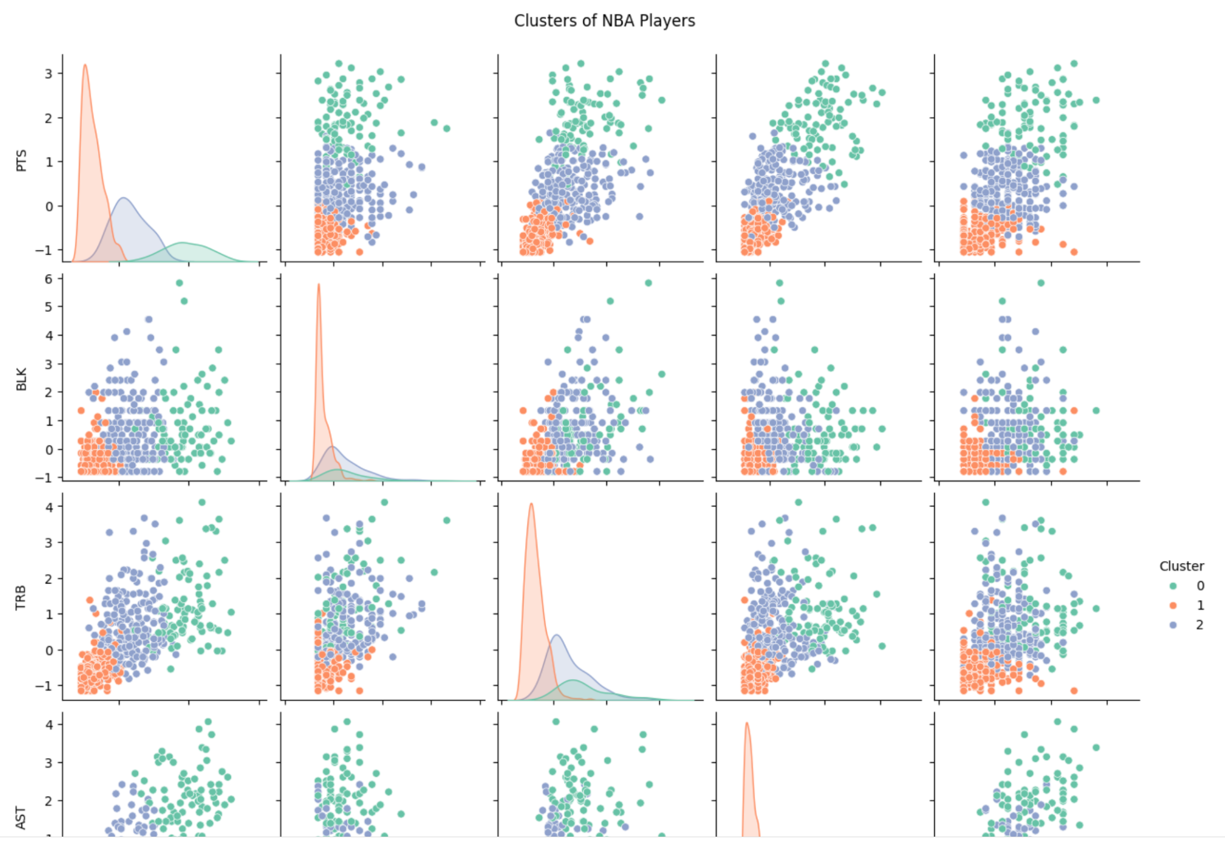
K-Means Clustering
K-Means clustering was applied to group NBA players into three distinct clusters based on performance metrics. Using the optimal cluster count of 3, K-Means assigns each player to a cluster based on their similarity in performance metrics.
After clustering, we calculated the average values for each metric within the clusters to understand their characteristics. Cluster 0 consists of high offensive players with lower defensive contributions, Cluster 1 includes balanced players who perform moderately across all metrics, and Cluster 2 represents strong defensive players with lower offensive outputs.
The pair plot below visualizes the clustering results, showing the distribution of players across key metrics. Each point represents a player, colored by their cluster assignment. This visualization highlights the separation and unique characteristics of each cluster.

Slide 8
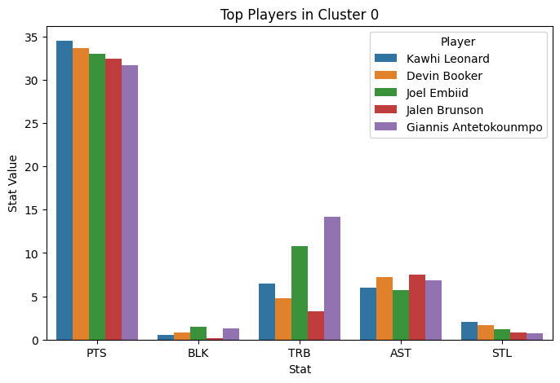
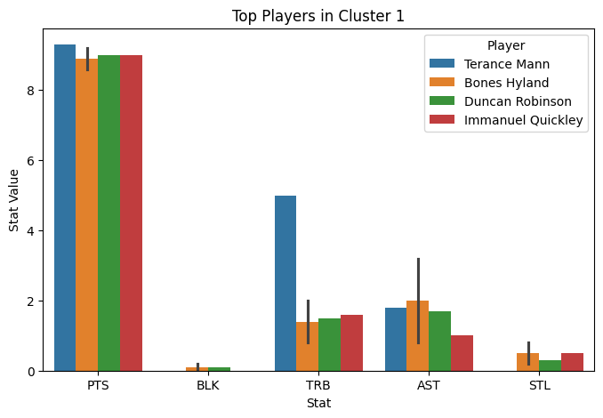
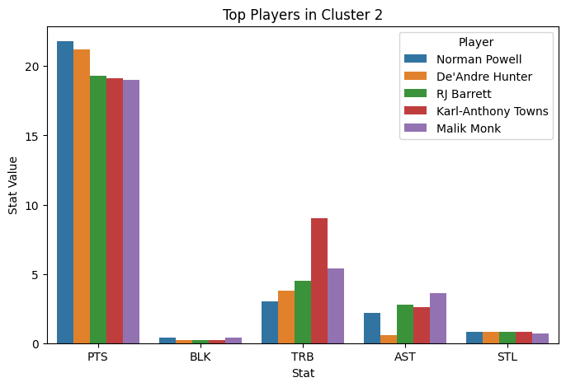
Clustering Results - Player Specific
Cluster 0 players dominate offensive metrics with high scoring outputs but contribute less defensively.
Cluster 1 players exhibit balanced metrics, making them
versatile team contributors.
Cluster 2 players excel in defensive metrics like blocks and steals but have lower scoring outputs.
We identified three distinct clusters:
Cluster 0: High offensive output (Offensive Superstars).
Cluster 1: Balanced contributors (Role Players).
Cluster 2: Defense-oriented players (Defensive Specialists).
These clusters provide insights into player roles and help identify standout performers in specific metrics, offering valuable perspectives for team management, player comparison, and sports analysis. Our analysis categorized NBA players into three unique clusters based on their performance metrics, such as Points (PTS), Rebounds (TRB), Assists (AST), Blocks (BLK), and Steals (STL).
The purpose of clustering was to identify patterns in player performance and group them into roles that reflect their contributions to the game.

Slide 9
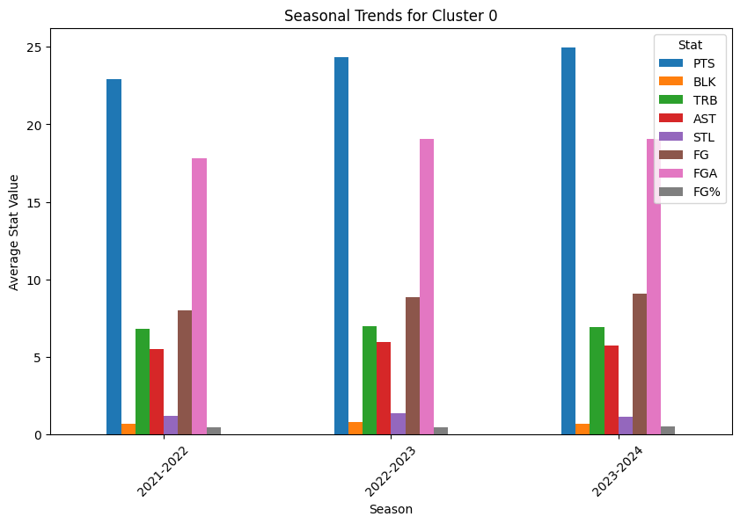
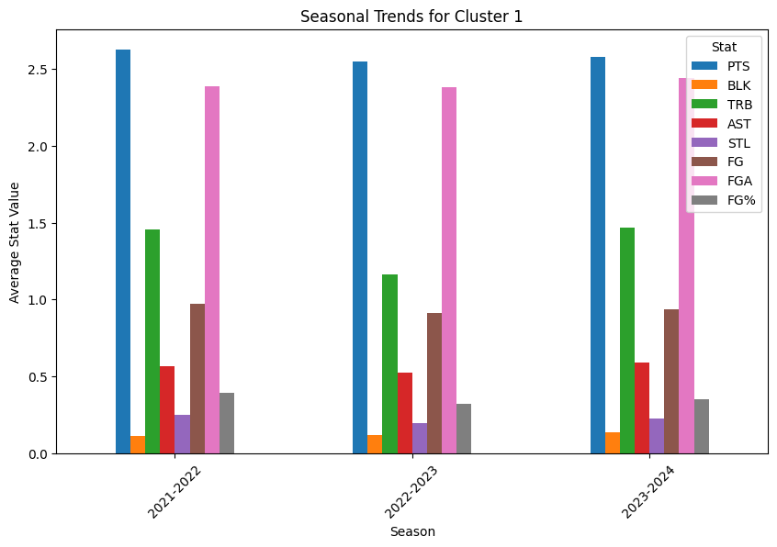
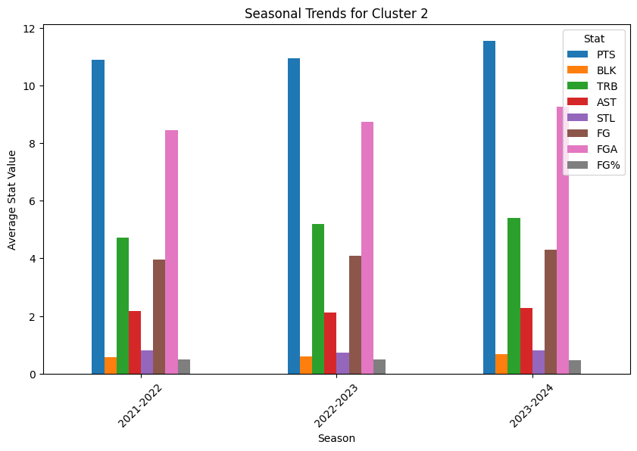
Clustering Results - Seasonal Analysis
This analysis highlights the performance trends of players in each cluster over three NBA seasons (2021-2022, 2022-2023, and 2023-2024). The graphs show how players in each cluster contribute to their roles, focusing on offensive and defensive metrics.
Key Observations:
Cluster 0 players show a steady increase in scoring and efficiency (FG%).
Cluster 1 players remain consistent in their balanced contributions across all metrics.
Cluster 2 players maintain strong defensive performances, with slight variations in rebounds and blocks across seasons
Cluster 0 - Offensive Superstars: Players in this cluster consistently score the highest points across all three seasons, with strong offensive metrics such as field goals made (FG) and attempted (FGA), but lower defensive contributions like blocks and steals."
Cluster 0 - Offensive Superstars: Players in this cluster consistently score the highest points across all three seasons, with strong offensive metrics such as field goals made (FG) and attempted (FGA), but lower defensive contributions like blocks and steals."
Cluster 1 - Role Players: Balanced players show steady performance across metrics. Their contributions are moderate in both offensive (e.g., points and assists) and defensive categories (e.g., rebounds and steals).
Cluster 2 - Defensive Specialists: Players in this cluster excel in defensive metrics such as rebounds and blocks while maintaining lower scoring outputs. Performance trends remain stable over the seasons.

Slide 10
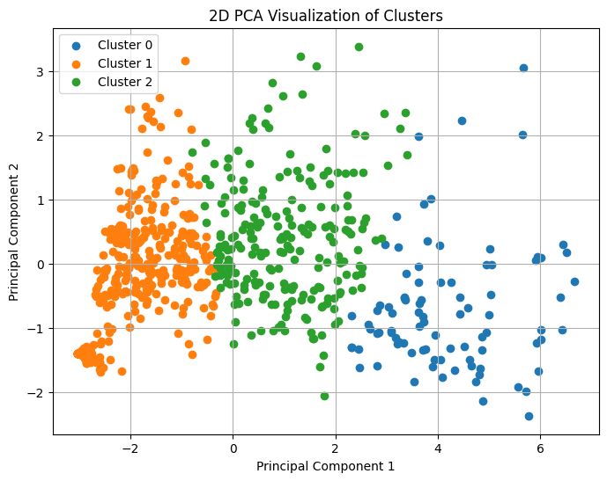
Cluster Visualization Using PCA
Purpose
This PCA plot is a dimensionality reduction visualization, showing how players are grouped into clusters based on their performance metrics. It simplifies the high-dimensional data into two principal components while preserving the variance as much as possible."
What is represented?
Each dot represents an individual NBA player. Players are grouped based on their similarity in metrics such as Points, Assists, Rebounds, and Defensive Contributions.
Insights
The clear separation between clusters reflects the distinct roles of players based on performance.
Some overlap (e.g., between Cluster 1 and Cluster 2) indicates shared characteristics, such as balanced players who also contribute defensively.
Cluster Descriptions:
Cluster 0 (blue): Offensive superstars who excel in scoring but have lower defensive contributions.
Cluster 1 (orange): Balanced role players who contribute evenly across metrics."
Cluster 2 (green): Defensive specialists who excel in rebounds, blocks, and steals."
Insights:
Notes:
Purpose:
"This 2D PCA plot is a dimensionality reduction visualization, showing how players are grouped into clusters based on their performance metrics. It simplifies the high-dimensional data into two principal components while preserving the variance as much as possible."
What Each Point Represents:
What is represented?
Each dot represents an individual NBA player. Players are grouped based on their similarity in metrics such as Points, Assists, Rebounds, and Defensive Contributions.
"The clear separation between clusters reflects the distinct roles of players based on performance."
"Some overlap (e.g., between Cluster 1 and Cluster 2) indicates shared characteristics, such as balanced players who also contribute defensively."

Slide 11
Conclusion
This analysis shows how useful it is to group NBA players together based on performance measures. The insights learned can be used in a number of real-world situations, including:
Team Building for Coaches: Coaches can use clusters to tweak practice sessions, pair players with skills that support each other, and plan strategies for games. For instance, players in Cluster 1 (who are good at offense) could practice against players in Cluster 3 (who are good at defense) to improve certain skills. During games, coaches can use defensive players to stop teams that score a lot of points, or they can use offensive players to attack teams with weak defenses.
Scouting and Recruiting: Scouts can use clustering data to figure out which players will fit in best when they are making trade or draft choices. In this case, if a team already has a lot of defensive depth, they wouldn't trade a great Cluster 1 player for a good Cluster 3 player. This method based on data guarantees a better team composition.
This project could be used in a lot of different ways in the NBA. The league already uses advanced data, but there's always room for improvement and new ideas. This project has not only shown how useful clustering is in sports analytics, but it has also helped us learn more about how data can be used to make important decisions. We're proud to have worked on a project that fits with what we love and taught us useful skills in data analysis and access.

Slide 12

THANK YOU

